Slide 1
Artificial Neural Network Surrogate Modeling for Machine Damage Accumulation
Problem 1
AAU
Amineh Zadbood & Teammates

Slide 2
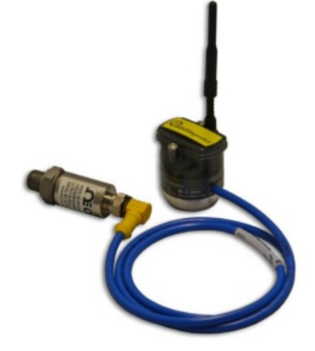
PROBLEM DESCRIPTION
Learning factory provides students with facilities for design, prototyping, and manufacturing. Several machines are equipped with sensors for predictive maintenance. They compute damage accumulation, which is influenced by measured values such as temperature, velocity, and acceleration. The objective is to create a data-driven surrogate model that enables a rapid computation of damage accumulation values based on the other measurements. This will facilitate more efficient and optimized maintenance and planning.

Slide 3
Data
Independent variables:
Dependent variable:
IX = X Axial (5 variables)
IY= Y Vertical (5 variables)
V = Voltage (1 variable)
T1 = Day and Time* (2 variables)
T2 = Only one-time index (1 variable)
DX = Damage X (1 variable)
DY = Damage Y (1 variable)
* Divided day and time into two separate features indexed accordingly

Slide 4
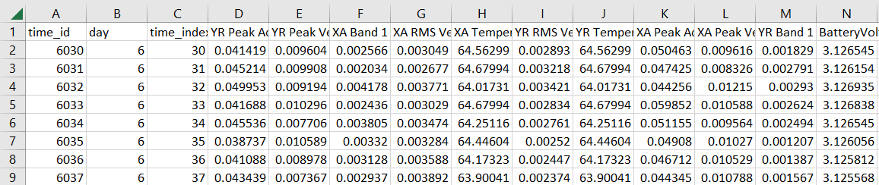
Data Preprocessing
Mapping time into day and time index
Detecting missing time stamps and variable values
Employing interpolation to fill in the gaps

Slide 5
Data Preprocessing: Correlation Matrix
The Data was then further analyzed for every machine by looking at the correlation matrix(Pearson correlation) for all variables.
Example of this for lathe week 1 is demonstrated in the next slide.

Slide 6
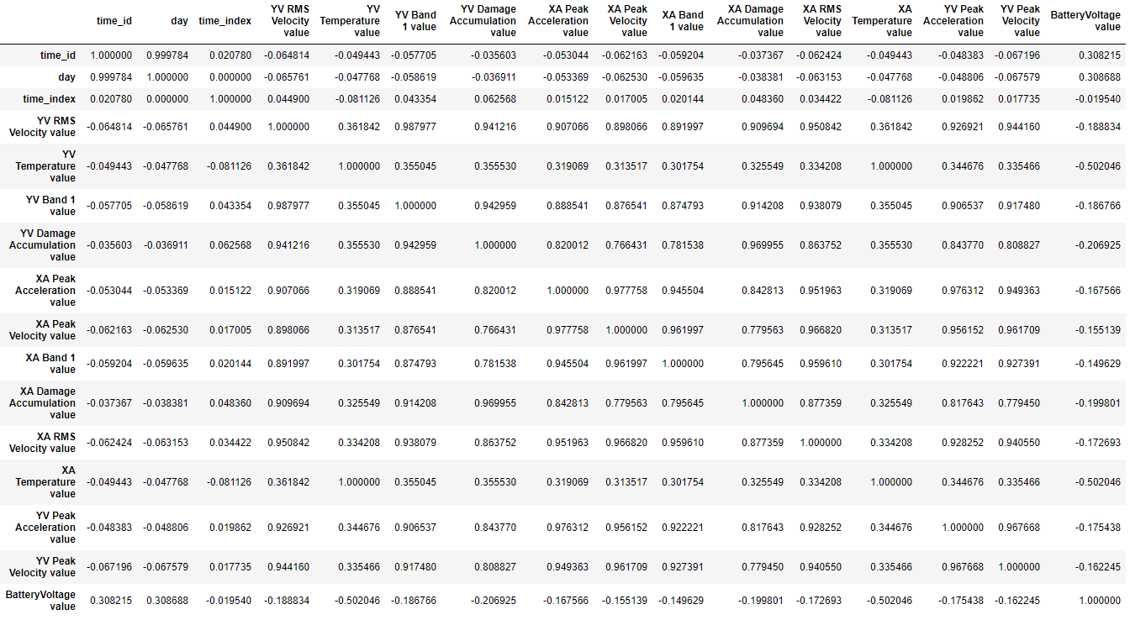

Slide 7
Data Preprocessing: Correlation Matrix
From all correlation matrices there was a clear and relevant correlation between all variables(all correlation coefficients above 0.05 or below -0.05). Therefore for the model it would be permissible to use all variables for predictions so long as the implementation is practical. For a neural network this would not be a huge hurdle, but if a conventional regression model is to be used then for practicality it is best to limit the analysis to variables that are more correlative to prevent dealing with very complex regression models.

Slide 8
Data Preprocessing - variable selection Covariance matrix of IX
 | IX
 | RMS Vel | Temp | Peak Acc | Peak Vel | Band
RMS Vel | 1 | 0.129779 | 0.72237 | -0.05171 | 0.870838
Temp | 0.129779 | 1 | 0.077133 | 0.107778 | 0.103911
Peak Acc | 0.72237 | 0.077133 | 1 | -0.17253 | 0.539101
Peak Vel | -0.05171 | 0.107778 | -0.17253 | 1 | -0.0319
Band | 0.870838 | 0.103911 | 0.539101 | -0.0319 | 1

Slide 9
Data Preprocessing - variable selection Covariance matrix of IY
 | IX
 | RMS Vel | Temp | Peak Acc | Peak Vel | Band
RMS Vel | 1 | -0.37306 | -0.05336 | 0.843135 | 0.793819
Temp | -0.37306 | 1 | 0.229845 | -0.34259 | -0.32301
Peak Acc | -0.05336 | 0.229845 | 1 | -0.06939 | -0.05191
Peak Vel | 0.843135 | -0.34259 | -0.06939 | 1 | 0.98282
Band | 0.793819 | -0.32301 | -0.05191 | 0.98282 | 1

Slide 10


Challenge: Which approach to take?
Or
Image credit: https://www.google.com/url?sa=i&url=https%3A%2F%2Fwww.analyticsvidhya.com%2Fblog%2F2016%2F08%2Fevolution-core-concepts-deep-learning-neural-networks%2F&psig=AOvVaw1Pzrv_262s6YO1ktfvLlhQ&ust=1597697095403000&source=images&cd=vfe&ved=0CA0QjhxqFwoTCPixx9PLoOsCFQAAAAAdAAAAABADto fit the best model

Slide 11
Approach
Both models were developed by the team with half of the effort going to developing appropriate regression models and the other half of the effort went to setting up and training a neural network.
At the end the trained multilayered perceptron(MLP) approach was found to be superior with R² values above 0.95. As a result the team moved forward with the MLP approach.

Slide 12
Regression
Multiple Techniques include:
Linear (Simple, interaction linear, robust linear)
Trees (Fine tree, coarse tree, medium tree)
Gaussian Process Regression (squared exponential, exponential)
Support Vector machine
Also tried different permutations of models:
Only RMS velocity and Peak acceleration with Damage
Only RMS velocity, Peak velocity and Peak acceleration with Damage
…and so on
Best one included all but battery.
We were able to get R-sqaured values of 0.78 and above. Mostly because of the 0 baseline values.

Slide 13
Approach
Furthermore there are many examples for predictive models in more recent literature published in both mechanical engineering fields and computer science which have demonstrated the superiority of the MLP approach to traditional approaches.

Slide 14
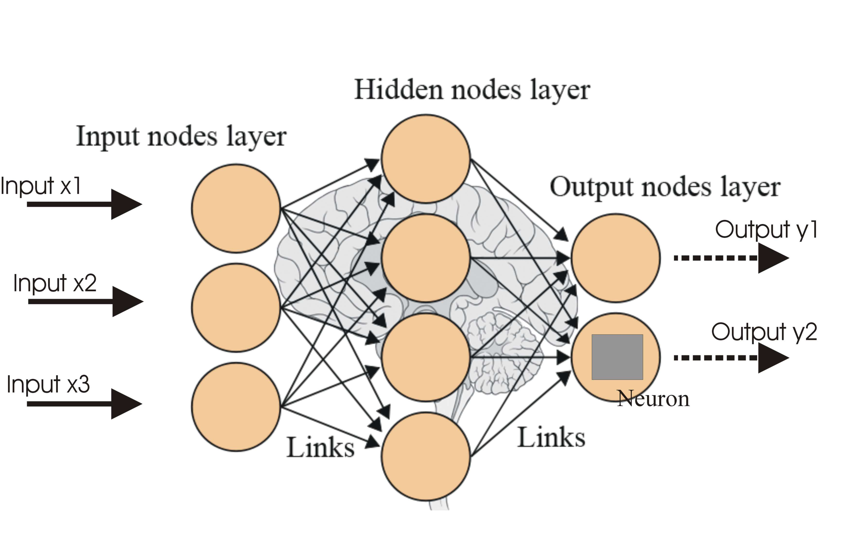
Approach
We use an artificial neural network with an input layer size of 11(all features) and output size of (2) damage variables with 6 hidden layers
Image credit: https://www.google.com/url?sa=i&url=https%3A%2F%2Fwww.analyticsvidhya.com%2Fblog%2F2016%2F08%2Fevolution-core-concepts-deep-learning-neural-networks%2F&psig=AOvVaw1Pzrv_262s6YO1ktfvLlhQ&ust=1597697095403000&source=images&cd=vfe&ved=0CA0QjhxqFwoTCPixx9PLoOsCFQAAAAAdAAAAABADto fit the best model

Slide 15
Model Architecture
To prevent overfitting in the model two dropout layers where added after each of the 64 neuron hidden layers. The size of these layers and the general architecture of this model was inspired by the extremely successful VGG-19 model’s flat layers.
Input Layer(11)
Dense Layer(256)
Dense Layer(256)
Dense Layer(128)
Dense Layer(128)
Dense Layer(64)
Dense Layer(64)
Out Layer(2)

Slide 16
Comparison
Bridgeport 2 – X Damage
Bridgeport 1 – Y Damage

Slide 17
Findings and Discussion
The high R squared values implies that learning factory can use these predictions to calculate damage accumulations and assess future scenarios.

